Slide 1

The Elements of Scale
How to Overcome WB and Nation-State Balance Sheet and Risk Constraints for low-cost (IBRD rate) lending to developing countries for green investment
Climate Café
Thursday, February 9th, 2023
Stephen Stretton
ETC, World Bank
EFI Climate Economics, and MTI Fiscal Policy and Sustainable Growth Unit

Slide 2
Contents
Research Question & Scope
Context
Investment Needs: Financing a Green ‘Big Push’ in Developing Countries
Risk Transfer: WB syndication; Miga guarantees; Derisked Debt
Risk and FX Risk in Particular
Blended Shared Equity Financial Model
Conclusion & Discussion
Appendix: Financial Structures and Modelling

Slide 3
Research Question & Scope

Slide 4
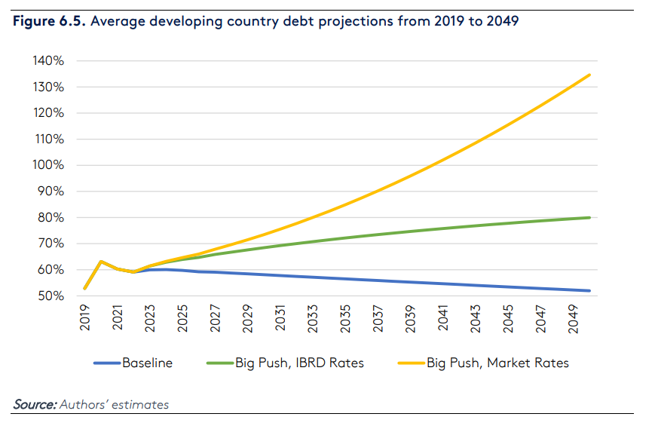
The Question: An Overview
Green finance must be scaled up
We must do this at low interest rates
The WB balance sheet is too small.
Therefore, we need to work out how to mobilize additional financing.
To reduce fiscal risk, we need to do contradictory things: we need ‘more state/WB’ (to reduce interest rates and to ensure investment happens in risk developing countries); and we need ‘less state/WB’ (to reduce fiscal debt and given balance sheet limitations).
How resolve this?

Slide 5
Scope Today
Projects that can be financed at low interest rates now (Out of scope)
Projects that can be financed at low interest rates only with financial structuring and with expansion of WB/inc IFC balance sheets (perhaps expansion beyond what is feasible)
Projects that need subsidies even with derisking (Out of scope)
Scope today

Slide 6
Wider Objectives (beyond this talk)
01
Governing the green transition
Every country has option to lodge a technical plan for rapid decarbonisation (simple initially) with the World Bank and get it derisked, supported technically and financed
Not in Scope today
02
Institutionalising green stimulus as macro-economic policy
Macro policy has issues: QE pumps up asset prices
  Big fiscal deficits are balance sheet suboptimal: splurging cash without long-term assets
  Green finance adds growth AND productive assets
03
Reducing borrowing costs by financial derisking
A renewable investment with storage is inherently a safe investment.
But financially, it’s riskier than a mortgage
Derisking debt can help
Scope today
04
Creating a rapidly growing publicly-shared equity fund
An initial equity stake fund, set up by governments and small investors would take 80% of the profits from the derisking. The equity stake would be sold.
The equity fund would be reinvested but 2/3 of the profit allocated to the people of the recipient country
Requires WB leadership
05
Global green financial coordination and incentives
A global equity fund allows rapid coordination
It also incentivises countries to act fast.

Slide 7
How to do it?
Create a concrete plan to decarbonize power and to electrify other sectors (e.g., transport)
Comprehensive financial derisking, securitisation and government guarantees of bonds in renewable electricity generation projects, leading to very low-cost borrowing (and once derisked, the central bank can purchase)
Create an equity fund to initially finance projects, sell that once complete and recycle. Project equity shared between private-sector equity investment and public-sector equity fund. The public sector equity fund would provide initial financing only, once the project is complete, this equity would be sold to the private sector at a profit This shared public equity fund has several functions and is expected to grow over time.

Slide 8
Context

Slide 9
Context
1.5C Paris agreement target requires rapid and immediate action to decarbonise whole economies within a decade or two.
Meeting net zero targets will require decarbonising and expanding the power sector and electrifying the other sectors.
Fortunately, renewables are now cheap, but financial costs can make up to half the total cost of generating electricity due to high interest rates.
Risk capital requiring reasonable rates of return is scarce, especially in developing countries.
On the other hand, pension funds, insurance funds and central banks purchase very low risk investments, driving down yields on high rated sovereign debt. There is plenty of money at low interest for safe investments.

Slide 10
More Context: The problem with national targets
Let’s say we want to meet a 2C target.
National governments set emissions reductions consistent with that targets
The problem is that not all countries will cooperate
This means we will miss the target!
How to succeed - incentives and coordination

Slide 11
More Context: Pension Funds
Partly thanks to regulations on pension funds, there are plenty of funds, at low interest rates, associated with low risk A to AAA rated investments
But that money needs to find its way to green investment
We wish in this to leverage scarce public funds
We also want to make public equity profitable

Slide 12
More Context: A Better Way to Do Macro-Growth Policy?
In terms of macroeconomic growth policy, low interest rates (monetary policy) are ineffective at stimulating growth, and cause housing and wealth inequality. Public deficits (fiscal policy) are effective in the short term but can be balance-sheet suboptimal to the long term fiscal position, especially in developing countries
  Monetary Policy (Low Interest rates) causes pumping up asset prices and increases inequality
  Fiscal policy uses up borrowing space for developing countries
  Coordinated technical plans with financing could add to growth and create extra real assets – a better form of macro growth policy

Slide 13
Q: Why can’t lending to renewables be more like a mortgage?
What do you pay on your mortgage? 1.5% interest pa
What does a renewable developer pay? 7% or more….

Slide 14
Investment Needs
Main Source: IEA Net zero report https://iea.blob.core.windows.net/assets/7ebafc81-74ed-412b-9c60-5cc32c8396e4/NetZeroby2050-ARoadmapfortheGlobalEnergySector-SummaryforPolicyMakers_CORR.pdf (Presentation)

Slide 15
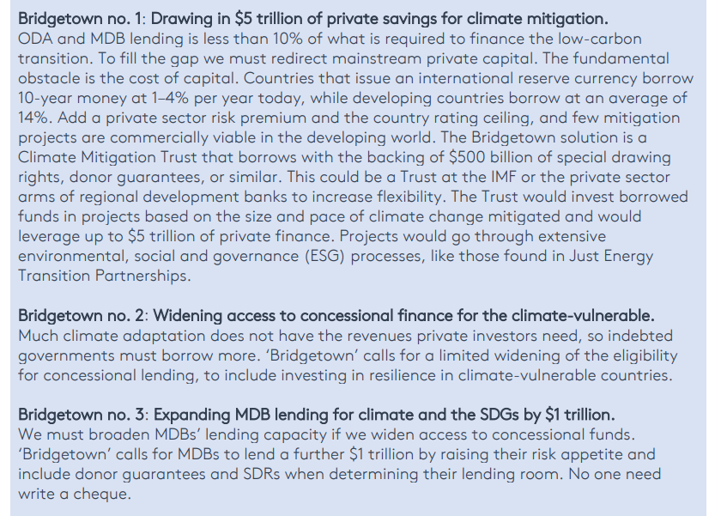
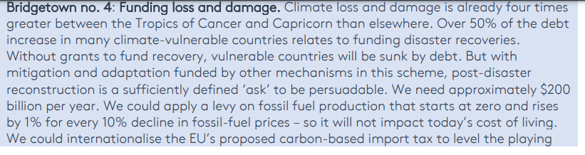
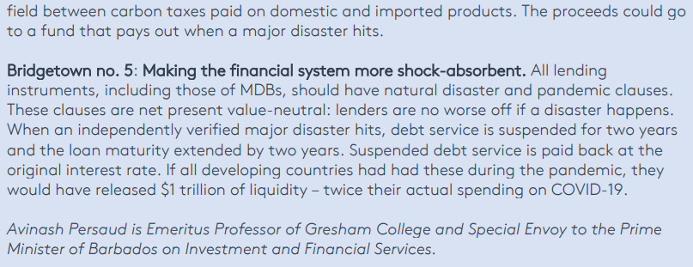
Bridgetown Five!

Slide 16
Bridgetown Five!
Mobilise $5tr in private savings
Widening access to concessional finance for the climate vulnerable
Expanding MDB lending by $1tr
Funding loss and damage (eg by carbon tax)
Making the intl. financial system more risk absorptive (e.g. natural disaster clauses)

Slide 17
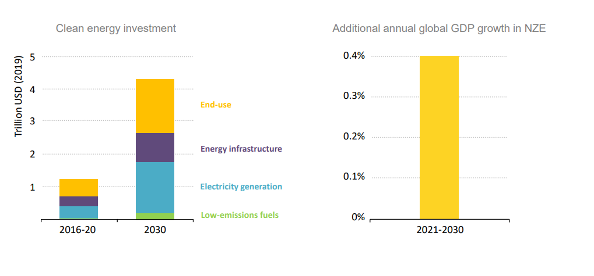
Clean Energy Investment (Global)
Source: IEA Net zero report https://iea.blob.core.windows.net/assets/7ebafc81-74ed-412b-9c60-5cc32c8396e4/NetZeroby2050-ARoadmapfortheGlobalEnergySector-SummaryforPolicyMakers_CORR.pdf

Slide 18
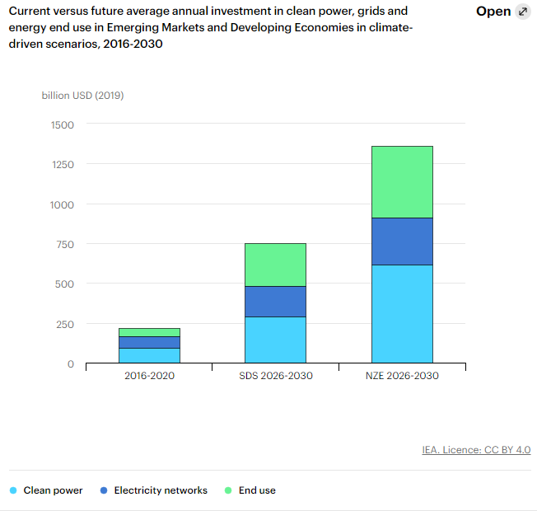
Emerging Market and Developing Economy (Excluding China) Only
$1tr/year gap
Source: https://www.iea.org/reports/financing-clean-energy-transitions-in-emerging-and-developing-economies/financing-clean-power-efficiency-and-electrification#abstract

Slide 19
The ‘Big Push’
Let’s call an internationally-coordinated attempt to meet net zero investment needs across state, private developed and developing countries a ‘big push’. What would it take to finance a big push

Slide 20
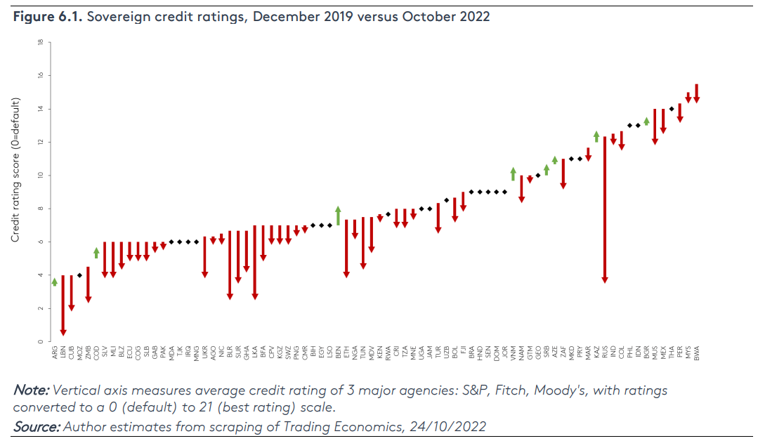
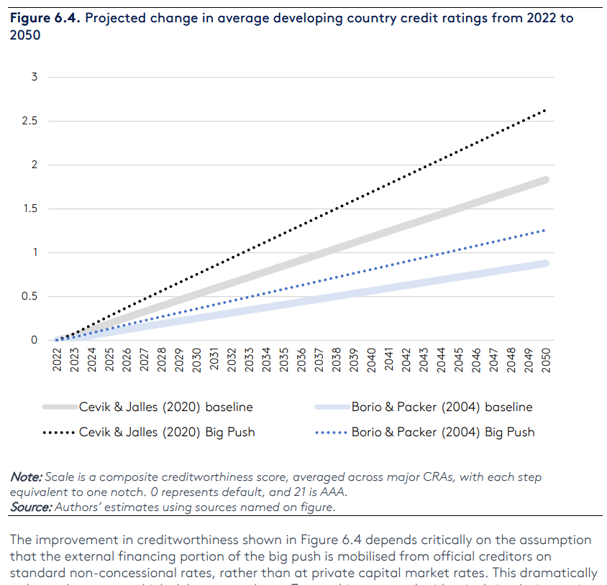
A big push can improve developing country credit ratings…
Current Ratings
Big push on climate: (slightly better developing country sovereign risk rates– including climate risks as well as fiscal position)

Slide 21
.. But only if at IBRD rates: not at market rates
Big push increases debt, but only somewhat at IBRD interest rates
At Market rates it leads to a compound-interest problem

Slide 22
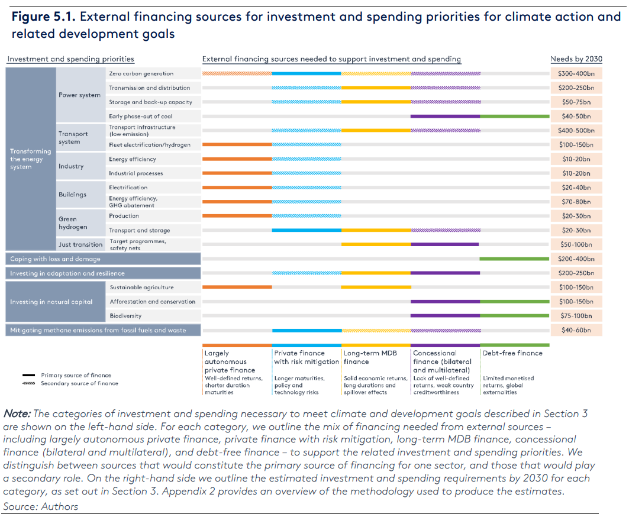
$2.5tr

Slide 23
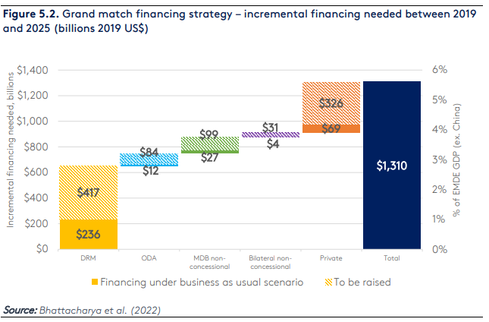

Slide 24
Financial Model

Slide 25
Financing Models
Public investment: IBRD + MIGA+Bank
Power: PPA + Derisked Debt
Private: Pay-as-you-go model
House Investment: Property Assessed Clean Energy Upgrades (PACE)
Also: access domestic financial markets by designing
(focus today)

Slide 26
Basic model:
Expand balances sheet of financial and risk intermediaries
We need to expand MDB balance sheets and organize the private sector
We must reduce risk (to get cost of capital down AND include MORE of private sector)
How?

Slide 27
Financial Models for Public & Power
IBRD (World Bank) lending
New! IBRD (World Bank) syndicated lending
MIGA guarantees
New! Guarantee and Securitize the Power Purchase Agreement
New! Add to (4) or (2) a For Public benefit Global Co-investment & Guarantee Equity Fund

Slide 28
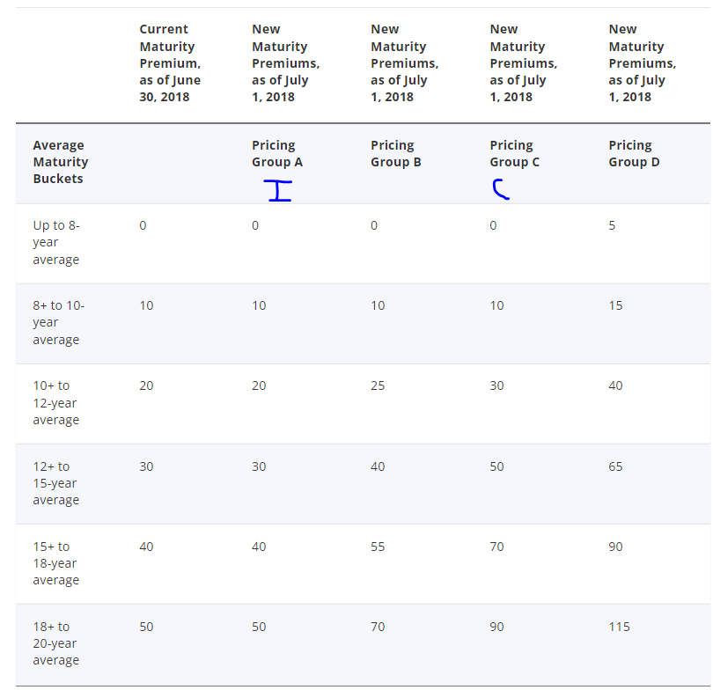
1 IBRD model
Basic IBRD model: Scale up with additional capital
WB can borrow at lower rate than developing country
Implicit ‘super seniority’ means that WB is paid back (not ever had a serious default). This is a promising model: but does WB have the balance sheet?
WB Lending costs
Costs above interbank rates in basis points: 50bp = 0.5%
I=India; C=China
Source: https://treasury.worldbank.org/en/about/unit/treasury/ibrd-financial-products/lending-rates-and-fees
Borrower
MDB Intermediary (WB)
Intl. Capital Markets

Slide 29
2 IBRD model (with Syndication)
Loan syndication: means the WB would sell on the loans it originates.
But are our loans priced at cost? (not far below but the difference might be ~0.5%-1% - ie cost of MIGA guarantees).
Either charge more (Does the IBRD compete if it charges 1% more)? Still cheaper than market rates.
If not, need a subsidy. Not insurmountable – a large equity fund could provide a first loss subsidy for syndicated in exchange for WB ‘final’ guarantees.
WB Lending costs
Costs above interbank rates in basis points: 50bp = 0.5%
I=India; C=China
Source: https://treasury.worldbank.org/en/about/unit/treasury/ibrd-financial-products/lending-rates-and-fees
Borrower
Intl. Capital Markets
MDB Intermediary (WB)

Slide 30
3 MIGA Reinsurance Model
MIGA Guarantees Provide a Solution as they are reinsured (ie does not use up balance sheet space)
MIGA quotes roughly 1% in fees.
Also relevant for (2) syndication.
Pricing
MIGA prices its guarantee premiums based on a calculation of both country and project risk. Fees average approximately one percent of the insured amount per year, but can be significantly lower or higher. Detailed information on premiums is available in Section VI of MIGA’s Operational Regulations.
Source: https://www.miga.org/terms-conditions
Borrower
Bank (private / not WB)
Intl. Capital Markets
Gov Contract/PPA etc
MIGA Guarantee
Reinsurance

Slide 31
4 Issue derisked debt off PPA (a sort of payment ‘securitization’)
Power purchase agreement (PPA) is securitized meaning its revenues are guaranteed and they directly pay bondholders OR local currency depositers (via fin tech phone app).
In India they use intermediate central contracting ie a AAA rated entity issues PPA
Special Purpose Vehicle
AAA Bond Market OR Domestic Depositors
Borrower
Priority
(‘securitization’ of PPA)
Backstop Guarantee
Guarantor

Slide 32
5 Add Coinvesting + Guarantee Fund
(4) Power purchase agreement is securitized meaning its revenues are guaranteed and they directly pay bondholders. (could also cross-subsidize (2) syndication).
Optionally, a for-public benefit equity fund(s) is set up that co-invests and backstop-guarantees
Special Purpose Vehicle
AAA Bond Market
Borrower
Priority
(‘securitization’ of PPA)
Backstop Guarantee
Coinvestor
Diversified Equity Fund incl Developing country small investors
Guarantor
Reinsurance

Slide 33
Risk and FX risk in particular

Slide 34
Risk and FX Risk: Problem
Let’s say we have a power purchase agreement
Let’s say we are in Turkiye and there’s high inflation and high inflation premium
It’s cheaper to borrow in USD but if our power is denominated in Lira then there’s a mismatch?
What happens if the Turkish Lira devalues? Then our financial obligations are in USD and our revenues in Lira -> Mismatch.
How to resolve?

Slide 35
Risk and FX Risk: Options
Make the PPA decline in time (best practice for sovereign risk management of liabilities). RE PPAs should decline (in hard currency or in real terms domestic currency) with international RE prices
Denominate in mixed international currency – Internationalize the PPA: meaning denominate it in a bunch of currencies not just USD (perhaps SDRs)
Use FX hedging –Expand the TCXFund provided by FMO (a dutch development bank): see https://www.tcxfund.com/ (Capitalise with the equity+guarantee fund described in this presentation)
OR Denominate in local currency with bank deposits providing the financing (directly or indirectly). Why? Often depositors don’t get a high interest rate on their savings even in a high-inflation environment. Captial efficient bonds or a money fund for banks or create a direct product for savers via financial innovation.

Slide 36
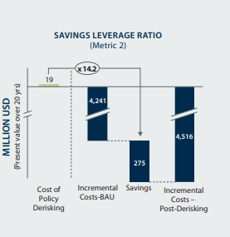
Policy Derisking and Barrier Elimination can return 14x what it costs
Derisking and/or High-Quality Financer (e.g. sovereign wealth funds, WB) can reduce financing costs MORE than the insurance ‘costs’
In the UN example (right) $19m USD in costs mobilises $275m USD in interest savings
-> Policy Derisking (barrier elimination) is highly profitable and recycled profits rather just reduction in costs could help scale up green equity (see next section)
Source: Derisking Renewable Energy Investment (2013), UNDP: https://www.undp.org/publications/original-drei-report

Slide 37
Risk: Where is the ‘financial profit’
Risk Reduction: pays for benefit
  MIGA Political Risk Reduction
Structuring
  To make relevant for pensions funds
  To make it relevant for macro policy
Competing In A Different Space
  Macroeconomic Policy:
Risk Reduction that comes for ‘free’ somehow
  Securitisation
Certainty reduces costs in itself, but reduces flexibility
  PPA, Planning

Slide 38
Discussion, Key Points
Financial models (eg PAYG)
Mobilize domestic savings & investments
FX risk & modelling
Quantify + Characterize investment needs. (size, creditworthiness of borrower) -> appropriate institution.
Prioritize investment (how)
Role of WB - share best practices on financial models

Slide 39
Blended Shared Equity Financial Model
How the equity fund could grow:
1 Organic appreciation based on initial financing and resale
2 Attract further funds thanks to the organic appreciation

Slide 40
Theory of Change
Reduction in Risk, Uncertainty
Certainty reduces costs in itself
Financial Profit -> Scaling Dynamics

Slide 41
Standard Financial Structure
Debt (not derisked)
$900k
Equity
$100k

Slide 42
New Financial Structure
Derisked Debt $900k
Equity $20k
Shared
Initial Equity $80k

Slide 43
New Financial Structure
Derisked Debt $900k
Derisked Debt
$900k
Equity $40k
Equity $20k
Shared
Initial Equity $80k
Shared
Initial Equity $160k

Slide 44
New Financial Structure
Derisked Debt $900k
Derisked Debt
$900k
Derisked Debt
$900k
Equity $40k
Equity
$200k
Equity $20k
Shared
Initial Equity $80k
Shared
Initial Equity $160k
Shared
Profit $80k

Slide 45
Conclusions

Slide 46
Better Climate Finance!
Plan the Transition
Create Global Incentives
Outcompete Fiscal and Monetary Policy
Reduce financial cost of Green transition
Create a universal basic capital fund for Everyone on the Planet
Condition National Participation on Carbon Price / Feebate
Create Profitable Financing to Enable Rapid Scaling
Condition National Participation on Nature Protection
Leverage scarce private capital

Slide 47
Other Applications
Reducing the financial cost of bank investments
Green-macro policy (Central Banks)
International Level (COP and WB): Concrete plans for derisking in exchange for financing
Create the fund! Financial inclusion for people in developing countries.

Slide 48
Conclusion
A country would have a technical plan for decarbonisation always including expansion of renewables through reducing financial risk eg through auctions
Renewables projects would be financed by debt and equity. The debt component of renewables projects would be derisked including guaranteeing the project bonds issued reducing project bond interest payments
The equity financing shared ¼ private and ¾ by a public shared fund. The public for-profit fund would be provided by rich government or small investors. Those public equity shares would be sold on at a profit once project is completed and well established. The shared equity fund has multiple functions.
The fund, would grow on behalf of individual investors (allocated to the population according to national participation). After it has retired, everyday people in developing countries could begin to access it.
Assuming WB leadership, national participation in this scheme could be conditional on a) a decarbonisation technical plan, b) carbon price reforms including feebates and c) protecting nature.
The project bonds, as they are safe assets, could also be bought by the central bank.

Slide 49
Discussion
Is the analysis correct in terms of the missing features of the institutional landscape?
Is the notion of ‘derisked AAA green bonds’ the correct one to mobilize trillions to developing countries and mobilize green investment for macroeconomic purposes?
What is the correct operationalization of an organized equity fund that meets institutional constraints (eg of the WB)?
How can this or similar ideas be taken forward?

Slide 50
Appendix 1: Derisking Financial Structure

Slide 51
State
Power Utility
Independent Power Project
Power
Revenues
An Independent Power Producer Sells Power to a State Utility

Slide 52
Guarantee Price of Power (auctioned)
State
Power Utility
Independent Power Project
Power
Revenues
Now the power utility or government guarantees the price paid, in exchange for storage

Slide 53
Guarantee Price of Power (auctioned)
Profit
State
Power Utility
Independent Power Project
Equity Investors
Power
Revenue
Interest
Bond Investors
The Power Project is financed both by bonds and equity investors

Slide 54
Remaining Revenue
Guarantee Price of Power (auctioned)
State
Power Utility
Independent Power Project
Equity Investors
Power
Revenue
Owns
Lower Interest
Government
Bond Investors
Guarantees
The government adds loan guarantees which lowers interest rates. Should the project default the government would reposess the asset.

Slide 55
Guarantee Price of Power (auctioned)
State
Power Utility
Independent Power Project
Equity Investors
Power
Owns
Remaining Revenue
Revenues
Government
Special Purpose Vehicle
Bond Investors
Even Lower
Interest
Guarantees
Securitisation of the revenues allows further reduction in risk for bond investors

Slide 56
Guarantee Price of Power (auctioned)
State
Power Utility
Independent Power Project
Equity Investors
Power
Owns
Remaining Revenue
Revenues
Government
Special Purpose Vehicle
Even Lower
Interest
Bond Investors
Guarantees
Secondary Guarantees
WB Group (WB, IFC, MIGA)
WB Guarantees reduce risk further

Slide 57
Guarantee Price of Power (auctioned)
State
Power Utility
Independent Power Project
Equity Investors
Power
Owns
Remaining Revenue
Revenues
Government
Special Purpose Vehicle
Even Lower
Interest
Bond Investors
Guarantees
Secondary Guarantees
WB Group (WB, IFC, MIGA)
Central Bank
Central Bank Purchases
CB Bond Purchases Reduce Rates Further

Slide 58
Shared Equity Fund
Long term Indemnity
Donor Government (20y loan)
Secondary Indemnity
WB Group (WB, IFC, MIGA)
Recipient Government
Primary Indemnity
WB is only initial holder of risk; recipient governments indemnify them with donor governments and the shared fund acting as secondary guarantors to ensure the WB holds no risk.

Slide 59
WB Group (WB, IFC, MIGA)
Lower Interest Costs
Governments
Derisking
Renewables
Leading To
More Profit
Central
Banks
Summary

Slide 60
Appendix 2: Financial Modelling

Slide 61
A Basic Project
 | Solar+Battery without Derisking | Solar+Battery with Derisking
Asset | Solar PV Utility Scale | Solar PV Utility Scale
Size | 1MW | 1MW
Capital cost $/MW | $1,000,000 | $1,000,000
Lifetime | 25 | 25
Capacity % | 20% | 20%
Power Produced Per Year | 1752 | 1752
Power Price USD/MWh | $ 51 | $ 51
Power Price USD/kWh | $ 0.05 | $ 0.05
Revenues | $ 90,000 | $ 90,000
Proportion of Debt | 80% | 80%
Proportion of Equity | 20% | 20%

Slide 62
A Basic Project
 | Renewables without Derisking | Renewables with Derisking
Debt Interest Rate | 7.5% | 2.5%
Equity Required Return | 15% | 15%
Cost of Capital | 9% | 5%
Required Revenues | $ 90,000 | $ 90,000
Price Earnings ratio | 6.7 | 6.7
Revenues | $ 90,000 | $ 90,000
Interest Costs per Year | $ 60,000 | $ 20,000
Profit per year | $ 30,000 | $ 70,000
Initial Equity Investment | $ 200,000 | $ 200,000
Equity Stake after appreciation (no risk) | $ 200,000 | $ 466,667
Equity Appreciation | 0% | 133%
Yearly Return after 25% provisions for default/costs |  | 100%
Equity Stake after appreciation | $ 200,000 | $ 400,000

